Slide 1
Simple Java Program
A class to display a simple message:
class MyProgram
{
public static void main(String[] args)
{
System.out.println(“First Java program.");
}
}

Slide 2
What is an Object?
Real world objects are things that have:
1) state
2) behavior
Example: your dog:
state – name, color, breed, sits?, barks?, wages tail?, runs?
behavior – sitting, barking, waging tail, running
A software object is a bundle of variables (state) and methods (operations).

Slide 3
What is a Class?
A class is a blueprint that defines the variables and methods common to all objects of a certain kind.
Example: ‘your dog’ is a object of the class Dog.
An object holds values for the variables defines in the class.
An object is called an instance of the Class

Slide 4
Object Creation
A variable is declared to refer to the objects of type/class String:
String s;
The value of s is null; it does not yet refer to any object.
A new String object is created in memory with initial “abc” value:
String s = new String(“abc”);
Now s contains the address of this new object.

Slide 5
Object Destruction
A program accumulates memory through its execution.
Two mechanism to free memory that is no longer need by the program:
1) manual – done in C/C++
2) automatic – done in Java
In Java, when an object is no longer accessible through any variable, it is eventually removed from the memory by the garbage collector.
Garbage collector is parts of the Java Run-Time Environment.

Slide 6
Class
A basis for the Java language.
Each concept we wish to describe in Java must be included inside a class.
A class defines a new data type, whose values are objects:
A class is a template for objects
An object is an instance of a class

Slide 7
Class Definition
A class contains a name, several variable declarations (instance variables) and several method declarations. All are called members of the class.
General form of a class:
class classname {
type instance-variable-1;
…
type instance-variable-n;
type method-name-1(parameter-list) { … }
type method-name-2(parameter-list) { … }
…
type method-name-m(parameter-list) { … }
}

Slide 8
Example: Class Usage
class Box {
double width;
double height;
double depth;
}
class BoxDemo {
public static void main(String args[]) {
Box mybox = new Box();
double vol;
mybox.width = 10;
mybox.height = 20;
mybox.depth = 15;
vol = mybox.width * mybox.height * mybox.depth;
System.out.println ("Volume is " + vol);
} }

Slide 9
Constructor
A constructor initializes the instance variables of an object.
It is called immediately after the object is created but before the new operator completes.
1) it is syntactically similar to a method:
2) it has the same name as the name of its class
3) it is written without return type; the default return type of a class
constructor is the same class
When the class has no constructor, the default constructor automatically initializes all its instance variables with zero.

Slide 10
Example: Constructor
class Box {
double width;
double height;
double depth;
Box() {
System.out.println("Constructing Box");
width = 10; height = 10; depth = 10;
}
double volume() {
return width * height * depth;
}
}

Slide 11
Parameterized Constructor
class Box {
double width;
double height;
double depth;
Box(double w, double h, double d) {
width = w; height = h; depth = d;
}
double volume()
{ return width * height * depth;
}
}

Slide 12
Methods
General form of a method definition:
type name(parameter-list) {
… return value;
…
}
Components:
1) type - type of values returned by the method. If a method does not return any value, its return type must be void.
2) name is the name of the method
3) parameter-list is a sequence of type-identifier lists separated by commas
4) return value indicates what value is returned by the method.

Slide 13
Example: Method
Classes declare methods to hide their internal data structures, as well as for their own internal use: Within a class, we can refer directly to its member variables:
class Box {
double width, height, depth;
void volume() {
System.out.print("Volume is ");
System.out.println(width * height * depth);
}
}

Slide 14
Parameterized Method
Parameters increase generality and applicability of a method:
1) method without parameters
int square() { return 10*10; }
2) method with parameters
int square(int i) { return i*i; }
Parameter: a variable receiving value at the time the method is invoked.
Argument: a value passed to the method when it is invoked.

Slide 15
Access Control: Data Hiding and Encapsulation
Java provides control over the visibility of variables and methods.
Encapsulation, safely sealing data within the capsule of the class Prevents programmers from relying on details of class implementation, so you can update without worry
Helps in protecting against accidental or wrong usage.
Keeps code elegant and clean (easier to maintain)

Slide 16
Access Modifiers: Public, Private, Protected
Public: keyword applied to a class, makes it available/visible everywhere. Applied to a method or variable, completely visible.
Default(No visibility modifier is specified): it behaves like public in its package and private in other packages.
Default Public keyword applied to a class, makes it available/visible everywhere. Applied to a method or variable, completely visible.

Slide 17
Private fields or methods for a class only visible within that class. Private members are not visible within subclasses, and are not inherited.
Protected members of a class are visible within the class, subclasses and also within all classes that are in the same package as that class.

Slide 18
Visibility
public class Circle {
private double x,y,r;
// Constructor
public Circle (double x, double y, double r) {
this.x = x;
this.y = y;
this.r = r;
}
//Methods to return circumference and area
public double circumference() { return 2*3.14*r;}
public double area() { return 3.14 * r * r; }
}

Slide 19
Keyword this
Can be used by any object to refer to itself in any class method
Typically used to
Avoid variable name collisions
Pass the receiver as an argument
Chain constructors

Slide 20
Keyword this
Keyword this allows a method to refer to the object that invoked it.
It can be used inside any method to refer to the current object:
Box(double width, double height, double depth) {
this.width = width;
this.height = height;
this.depth = depth;
}

Slide 21
Garbage Collection
Garbage collection is a mechanism to remove objects from memory when they are no longer needed.
Garbage collection is carried out by the garbage collector:
1) The garbage collector keeps track of how many references an object has.
2) It removes an object from memory when it has no longer any references.
3) Thereafter, the memory occupied by the object can be allocated again.
4) The garbage collector invokes the finalize method.

Slide 22
finalize() Method
A constructor helps to initialize an object just after it has been created.
In contrast, the finalize method is invoked just before the object is destroyed:
1) implemented inside a class as:
protected void finalize() { … }
2) implemented when the usual way of removing objects from memory is insufficient, and some special actions has to be carried out

Slide 23
Method Overloading
It is legal for a class to have two or more methods with the same name.
However, Java has to be able to uniquely associate the invocation of a method with its definition relying on the number and types of arguments.
Therefore the same-named methods must be distinguished:
1) by the number of arguments, or
2) by the types of arguments
Overloading and inheritance are two ways to implement polymorphism.

Slide 24
Example: Overloading
class OverloadDemo {
void test() {
System.out.println("No parameters");
}
void test(int a) {
System.out.println("a: " + a);
}
void test(int a, int b) {
System.out.println("a and b: " + a + " " + b);
}
double test(double a) {
System.out.println("double a: " + a); return a*a;
}
}

Slide 25
Constructor Overloading
class Box {
double width, height, depth;
Box(double w, double h, double d) {
width = w; height = h; depth = d;
}
Box() {
width = -1; height = -1; depth = -1;
}
Box(double len) {
width = height = depth = len;
}
double volume() { return width * height * depth; }
}

Slide 26
Parameter Passing
Two types of variables:
1) simple types
2) class types
Two corresponding ways of how the arguments are passed to methods:
1) by value a method receives a cope of the original value; parameters of simple types
2) by reference a method receives the memory address of the original value, not the value itself; parameters of class types

Slide 27
Call by value
class CallByValue {
public static void main(String args[]) {
Test ob = new Test();
int a = 15, b = 20;
System.out.print("a and b before call: “);
System.out.println(a + " " + b);
ob.meth(a, b);
System.out.print("a and b after call: ");
System.out.println(a + " " + b);
}
}

Slide 28
Call by refference
As the parameter hold the same address as the argument, changes to the object inside the method do affect the object used by the argument:
class CallByRef {
public static void main(String args[]) {
Test ob = new Test(15, 20);
System.out.print("ob.a and ob.b before call: “);
System.out.println(ob.a + " " + ob.b);
ob.meth(ob);
System.out.print("ob.a and ob.b after call: ");
System.out.println(ob.a + " " + ob.b);
}
}

Slide 29
Recursion
A recursive method is a method that calls itself:
1) all method parameters and local variables are allocated on the stack
2) arguments are prepared in the corresponding parameter positions
3) the method code is executed for the new arguments
4) upon return, all parameters and variables are removed from the stack
5) the execution continues immediately after the invocation point

Slide 30
Example: Recursion
class Factorial {
int fact(int n) {
if (n==1) return 1;
return fact(n-1) * n;
}
}
class Recursion {
public static void main(String args[]) {
Factorial f = new Factorial();
System.out.print("Factorial of 5 is ");
System.out.println(f.fact(5));
} }

Slide 31
String Handling
String is probably the most commonly used class in Java's class library. The obvious reason for this is that strings are a very important part of programming.
The first thing to understand about strings is that every string you create is actually an object of type String. Even string constants are actually String objects.
For example, in the statement
System.out.println("This is a String, too");
the string "This is a String, too" is a String constant

Slide 32
Java defines one operator for String objects: +.
It is used to concatenate two strings. For example, this statement
String myString = "I" + " like " + "Java.";
results in myString containing
"I like Java."

Slide 33
The String class contains several methods that you can use. Here are a few. You can
test two strings for equality by using
equals( ). You can obtain the length of a string by calling the length( ) method. You can obtain the character at a specified index within a string by calling charAt( ). The general forms of these three methods are shown here:
// Demonstrating some String methods.
class StringDemo2 {
public static void main(String args[]) {
String strOb1 = "First String";
String strOb2 = "Second String";
String strOb3 = strOb1;
System.out.println("Length of strOb1: " +
strOb1.length());

Slide 34
System.out.println ("Char at index 3 in strOb1: " +
strOb1.charAt(3));
if(strOb1.equals(strOb2))
System.out.println("strOb1 == strOb2");
else
System.out.println("strOb1 != strOb2");
if(strOb1.equals(strOb3))
System.out.println("strOb1 == strOb3");
else
System.out.println("strOb1 != strOb3");
} }
This program generates the following output:
Length of strOb1: 12
Char at index 3 in strOb1: s
strOb1 != strOb2
strOb1 == strOb3

Slide 35
Argument Passing
call-by-value
call-by-value copies the value of an argument into the formal parameter of the subroutine.
Changes made to the parameter of the subroutine have no effect on the argument.
call-by-reference
call-by-reference , a reference to an argument (not the value of the argument) is passed to the parameter.
Changes made to the parameter will affect the argument used to call the subroutine. As you will see, Java uses both approaches, depending upon what is passed.

Slide 36
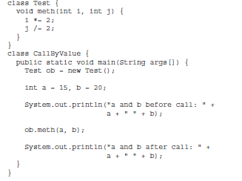

Slide 37
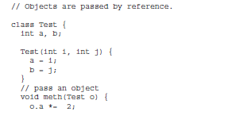
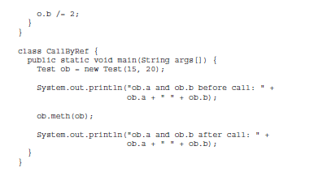

Slide 38
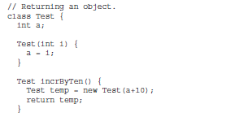
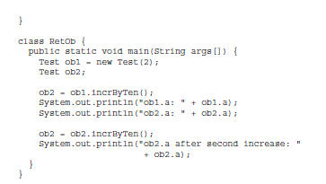

Slide 39
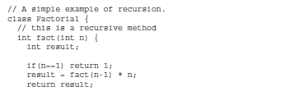
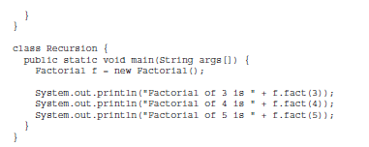

Slide 40
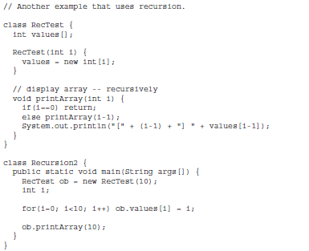

Slide 41
Encapsulation provides another important attribute: access control.
Encapsulation - control what parts of a program can access the members of a class.
Prevent misuse.
Java’s access specifiers are public, private, and protected
Java also defines a default access level. protected applies only when inheritance is involved.
When a member of a class is modified by the public specifier, then that member can be accessed by any other code.
When a member of a class is specified as private, then that member can only be accessed by other members of its class.

Slide 42
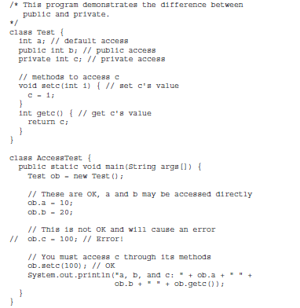

Slide 43
Static - When a member is declared static, it can be accessed before any objects of its class are created, and without reference to any object.
Both methods and variables to be static.
The most common example of a static member is main( ).
Instance variables declared as static are, essentially, global variables. When objects of its class are declared, no copy of a static variable is made. Instead, all instances of the class share the same static variable.
Methods declared as static have several restrictions:
They can only call other static methods.
They must only access static data.
They cannot refer to this or super in any way.

Slide 44

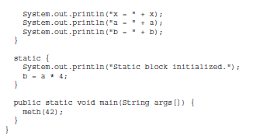

Slide 45

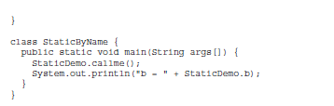
Call a static method from outside its class,
general form: classname.method( )

Slide 46
The final keyword in java is used to restrict the user.
Final can be:
variable
method
Class
Final Variable
Variable as final, you cannot change the value of final variable(It will be constant).
class Bike9{
final int speedlimit=90;//final variable
void run(){
speedlimit=400;
}
public static void main(String args[]){
Bike9 obj=new Bike9();
obj.run();
}
}

Slide 47
Java final method
If you make any method as final, you cannot override it.
class Bike{
final void run(){System.out.println("running");}
}
class Honda extends Bike{
void run(){System.out.println("running safely with 100kmph");}
public static void main(String args[]){
Honda honda= new Honda();
honda.run();
}
}
Final method is inherited but you cannot override it
class Bike{
final void run(){System.out.println("running...");}
}
class Honda2 extends Bike{
public static void main(String args[]){
new Honda2().run();
}
}

Slide 48
Java final class
If you make any class as final, you cannot extend it.
final class Bike{}
class Honda1 extends Bike{
void run(){System.out.println("running safely with 100kmph");}
public static void main(String args[]){
Honda1 honda= new Honda();
honda.run();
}
}

Slide 49
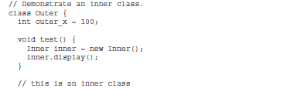
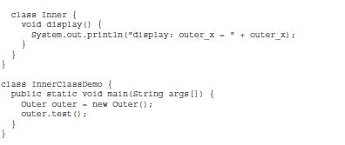

Slide 50
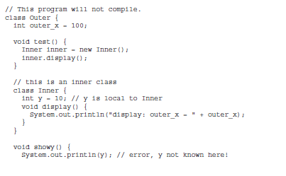
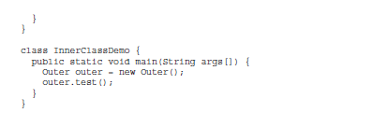

Slide 51
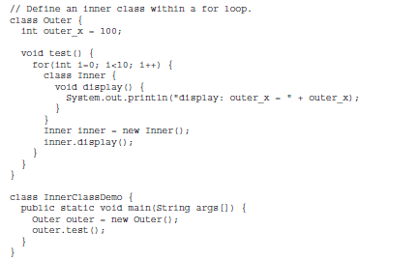

Slide 52
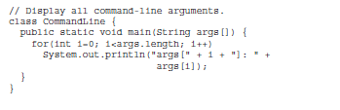
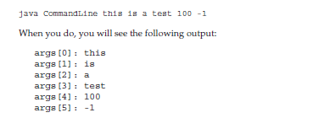

Slide 53
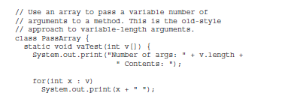
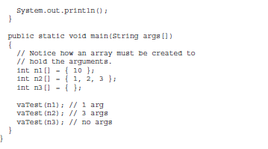

Slide 54

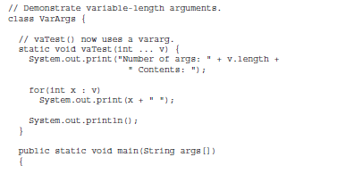
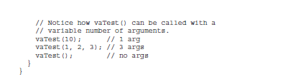

Slide 55
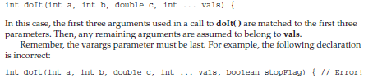


Slide 56
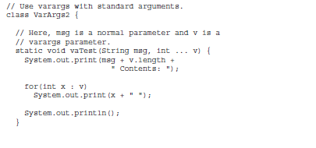
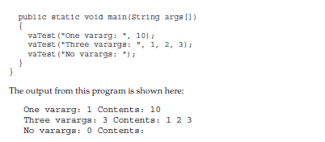

Slide 57
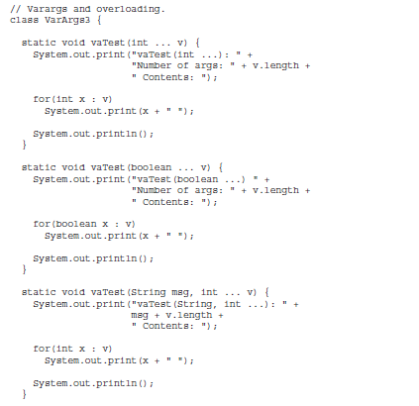

Slide 58
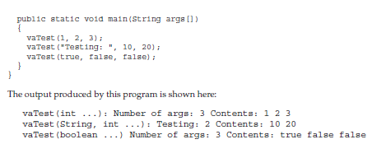

Slide 59
String
String is a sequence of characters.
Other languages that implement strings as character arrays
Java implements strings as objects of type String.
Once a String object has been created, you cannot change the
characters that comprise that string
Java provides two options: StringBuffer and StringBuilder.
Both hold strings that can be modified after they are created.
The strings within objects of type String are unchangeable means that the contents of the String instance cannot be changed after it has been created.
A variable declared as a String reference can be changed to point at some other String object at any time.

Slide 60
The String Constructors
To create an empty String
String s = new String();
you will want to create strings that have initial values
String(char chars[ ])
char chars[] = { 'a', 'b', 'c' };
String s = new String(chars);
You can specify a subrange of a character array as an initializer using the following constructor:
String(char chars[ ], int startIndex, int numChars)
char chars[] = { 'a', 'b', 'c', 'd', 'e', 'f' };
String s = new String(chars, 2, 3);

Slide 61
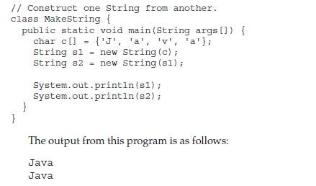
You can construct a String object that contains the same character sequence as another String object using this constructor:
String(String strObj)

Slide 62

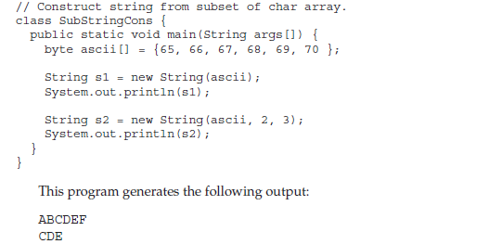

Slide 63
String Constructors Added by J2SE 5
String(int codePoints[ ], int startIndex, int numChars)
codePoints is an array that contains Unicode code points
String(StringBuilder strBuildObj)
String Length
int length( )
char chars[] = { 'a', 'b', 'c' };
String s = new String(chars);
System.out.println(s.length());
Special String Operations
The automatic creation of new String instances from string literals
Concatenation of multiple String objects by use of the + operator,
The conversion of other data types to a string representation.
There are explicit methods available to perform all of these funtions, but Java does them automatically as a convenience for the programmer

Slide 64
String Literals
char chars[] = { 'a', 'b', 'c' };
String s1 = new String(chars);
String s2 = "abc";
you can call methods directly on a quoted string as if it were an object reference, as the following statement shows.
System.out.println("abc".length());
String Concatenation
String age = "9";
String s = "He is " + age + " years old.";
System.out.println(s);

Slide 65
String Concatenation with Other Data Types
int age = 9;
String s = "He is " + age + " years old.";
System.out.println(s);
String s = "four: " + 2 + 2;
System.out.println(s);
This fragment displays
four: 22
rather than the
four: 4
To complete the integer addition first, you must use parentheses, like this:
String s = "four: " + (2 + 2);
Now s contains the string “four: 4”.

Slide 66
String Conversion and toString( )
// Override toString() for Box class.
class Box {
double width;
double height;
double depth;
Box(double w, double h, double d) {
width = w;
height = h;
depth = d;
}
public String toString() {
return "Dimensions are " + width + " by " +
depth + " by " + height + ".";
} }
class toStringDemo {
public static void main(String args[]) {
Box b = new Box(10, 12, 14);
String s = "Box b: " + b; // concatenate Box object
System.out.println(b); // convert Box to string
System.out.println(s);
} }

Slide 67




Slide 68
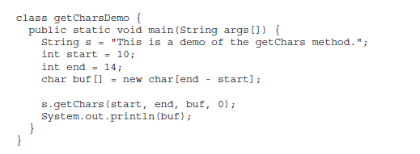


Slide 69



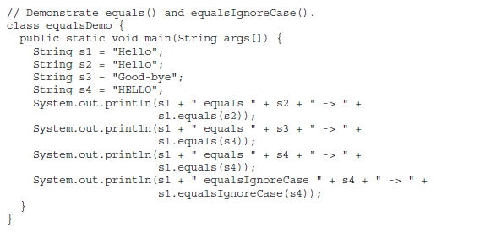

Slide 70





Slide 71
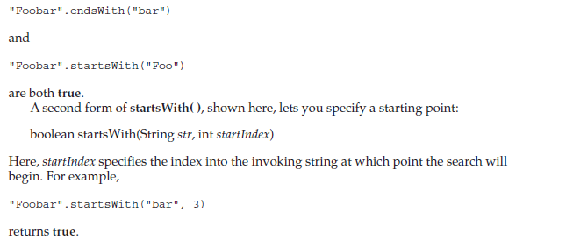

Slide 72

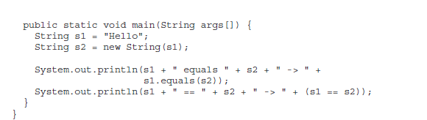

Slide 73
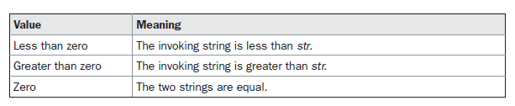
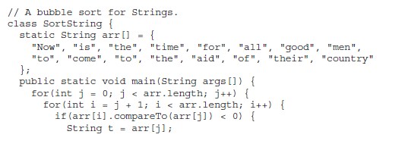

Slide 74
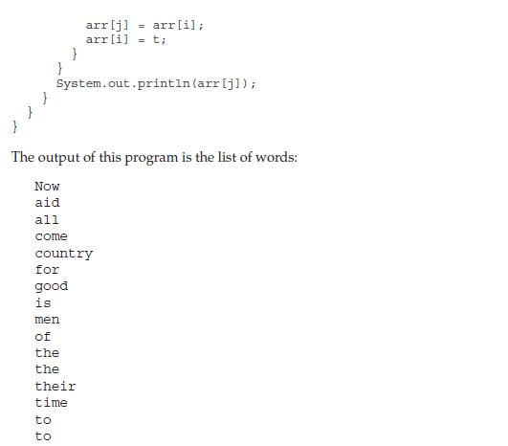

Slide 75

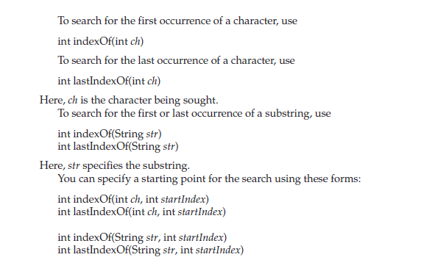

Slide 76
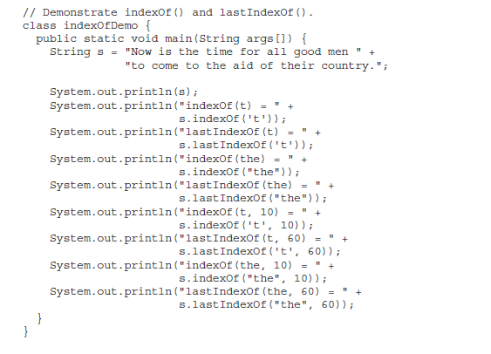

Slide 77

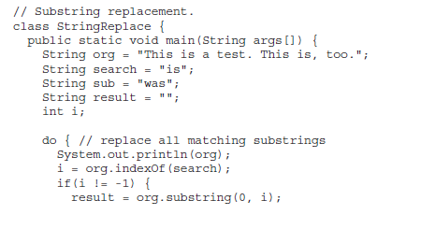

Slide 78
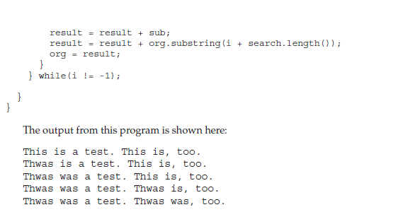

Slide 79





Slide 80
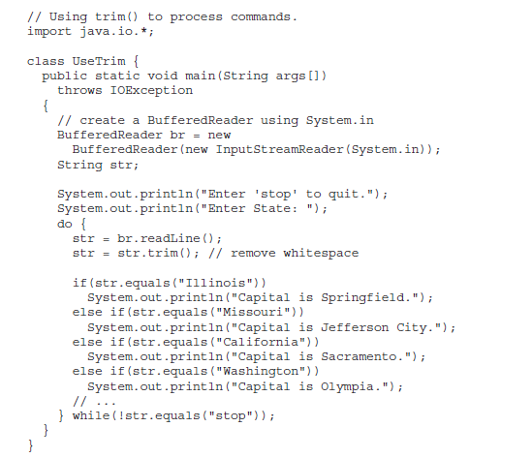

Slide 81



Slide 82
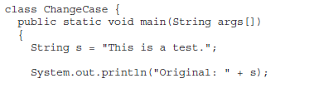
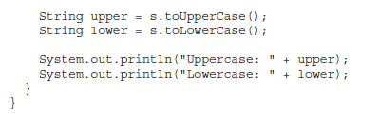

Slide 83
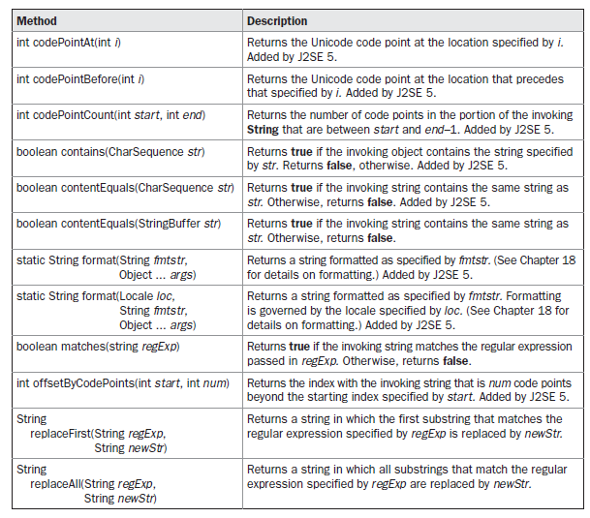

Slide 84
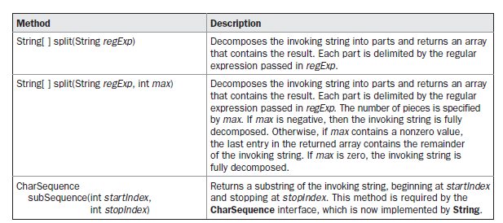

Slide 85
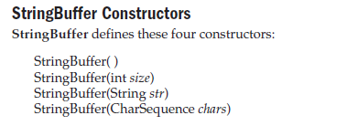

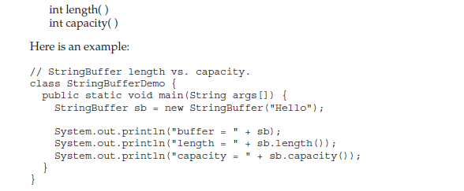

Slide 86




Slide 87
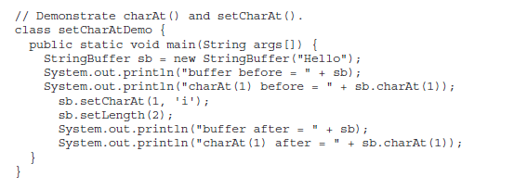

Slide 88


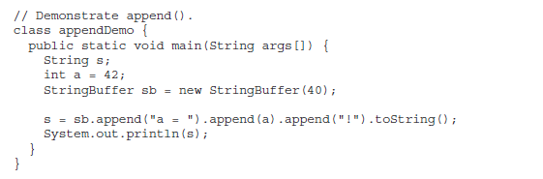

Slide 89

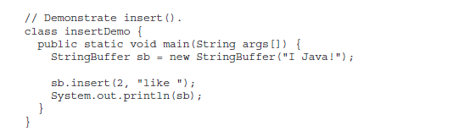

Slide 90


Slide 91




Slide 92


Slide 93


Slide 94


Slide 95
Naming conventions
Java naming convention is a rule to follow as you decide what to name your identifiers such as class, package, variable, constant, method etc.
But, it is not forced to follow. So, it is known as convention not rule.
All the classes, interfaces, packages, methods and fields of java programming language are given according to java naming convention.

Slide 96
Advantage of naming conventions in java
By using standard Java naming conventions, you make your code easier to read for yourself and for other programmers.
Readability of Java program is very important. It indicates that less time is spent to figure out what the code does.

Slide 97
convention
Name | Convention
class name | should start with uppercase letter and be a noun e.g. String, Color, Button, System, Thread etc.
interface name | should start with uppercase letter and be an adjective e.g. Runnable, Remote, ActionListener etc.
method name | should start with lowercase letter and be a verb e.g. actionPerformed(), main(), print(), println() etc.
variable name | should start with lowercase letter e.g. firstName, orderNumber etc.
package name | should be in lowercase letter e.g. java, lang, sql, util etc.
constants name | should be in uppercase letter. e.g. RED, YELLOW, MAX_PRIORITY etc.

Slide 98
Java bean
A Java Bean is a java class that should follow following conventions:
It should have a no-arg constructor.
It should be Serializable.
It should provide methods to set and get the values of the properties, known as getter and setter methods.

Slide 99
Why use Java Bean?
According to Java white paper, it is a reusable software component.
A bean encapsulates many objects into one object, so we can access this object from multiple places.
Moreover, it provides the easy maintenance.

Slide 100
Definitions
A reusable software component that can be manipulated visually in a ‘builder tool’. (from JavaBean Specification)
The JavaBeans API provides a framework for defining reusable, embeddable, modular software components.

Slide 101
Simple example of java bean class
//employee.java
Package mypack;
Public class employee implementsjava.io.serializiable
{
private int id;
private string name;
public employee()
{ }

Slide 102
public void setId(int id)
{
this.id=id;
}
public int getId()
{
Return id;
}

Slide 103
Public void setName(String name)
{
This.name=name;
}
Public string getName()
{
Return name;
} }
How to access the java bean class?
Package mypack;
Public class test
{
Public static void main(string args[])
{
Employee e=new employee();
e.setName(“Arjun”);
System.out.println(e.getName());
e.setId(10112);
System.out.println(e.getId());
}
}

Slide 104
Advantages of Java Beans
The following list enumerates some of the benefits that Java Bean technology provides for a component developer:
• A Bean obtains all the benefits of Java’s “write-once, run-anywhere” paradigm.
The properties, events, and methods of a Bean that are exposed to another application can be controlled.
• Auxiliary software can be provided to help configure a Bean. This software is only needed when the design-time parameters for that component are being set. It does not need to be included in the run-time environment.
• The state of a Bean can be saved in persistent storage and restored at a later time.
• A Bean may register to receive events from other objects and can generate events that are sent to other objects.

Slide 105
Introspection
At the core of Java Beans is introspection. This is the process of analyzing a Bean to determine its capabilities.
This is an essential feature of the Java Beans API because it allows another application, such as a design tool, to obtain information about a component. Without introspection, the Java Beans technology could not operate.

Slide 106
Design Patterns for Properties
A property is a subset of a Bean’s state. The values assigned to the properties determine the behavior and appearance of that component. A property is set through a setter method.
property is obtained by a getter method. There are two types of properties: simple and indexed

Slide 107
Simple property
A simple property has a single value. It can be identified by the following design patterns,
where N is the name of the property and T is its type:
public T getN( )
public void setN(T arg)
A read/write property has both of these methods to access its values.
A read-only property has only a get method. A write-only property has only a set method.

Slide 108
Simple property
private double depth, height, width;
public double getDepth( ) {
return depth;
}
public void setDepth(double d) {
depth = d;
}
public double getHeight( ) {
return height;
}
public void setHeight(double h) {
height = h;
}
public double getWidth( ) {
return width;
}
public void setWidth(double w) {
width = w;
}

Slide 109
An indexed property consists of multiple values. It can be identified by the following design
patterns, where N is the name of the property and T is its type:
public T getN(int index);
public void setN(int index, T value);
public T[ ] getN( );
public void setN(T values[ ]);

Slide 110
Indexed property
Here is an indexed property called data along with its getter and setter methods:
private double data[ ];
public double getData(int index) {
return data[index];
}
public void setData(int index, double value) {
data[index] = value;
}
public double[ ] getData( ) {
return data;
}
public void setData(double[ ] values) {
data = new double[values.length];
System.arraycopy(values, 0, data, 0, values.length);
}

Slide 111
Bound and Constrained Properties
A Bean that has a bound property generates an event when the property is changed. Theevent is of type PropertyChangeEvent and is sent to objects that previously registered an interest in receiving such notifications. A class that handles this event must implement the
PropertyChangeListener interface.
A Bean that has a constrained property generates an event when an attempt is made tochange its value. It also generates an event of type PropertyChangeEvent

Slide 112
beaninfo
The BeanInfo interface enables you to explicitly control what
information is available.
The BeanInfo interface defines several methods, including these:
PropertyDescriptor[ ] getPropertyDescriptors( )
EventSetDescriptor[ ] getEventSetDescriptors( )
MethodDescriptor[ ] getMethodDescriptors( )
They return arrays of objects that provide information about the properties, events, and
methods of a Bean. The classes PropertyDescriptor, EventSetDescriptor, and MethodDescriptor
are defined within the java.beans package, and they describe the indicated elements. By
implementing these methods, a developer can designate exactly what is presented to a user,
bypassing introspection based on design patterns.
When creating a class that implements BeanInfo, you must call that class bnameBeanInfo,
where bname is the name of the Bean. For example, if the Bean is called MyBean, then the
information class must be called MyBeanBeanInfo.

Slide 113
Persistence
Persistence is the ability to save the current state of a Bean, including the values of a Bean’s properties and instance variables, to nonvolatile storage and to retrieve them at a later time.
The object serialization capabilities provided by the Java class libraries are used to provide persistence for Beans.
The easiest way to serialize a Bean is to have it implement the java.io.Serializable
interface, which is simply a marker interface. Implementing java.io.Serializable makes
serialization automatic.

Slide 114
Customizers
A Bean developer can provide a customizer that helps another developer configure the Bean.
A customizer can provide a step-by-step guide through the process that must be followed to use the component in a specific context.

Slide 115
Intro to JavaBeans
What are JavaBeans?
Software components written in Java
Connect and Configure Components
Builder Tools allow connection and configuration of Beans
Begins ‘Age of Component Developer’
Bringing Engineering methods to Software Engineering (e.g. electronics…)

Slide 116
The JavaBeans API
Features implemented as extensions to standard Java Class Library
Main Component Services
GUI merging
Persistence
Event Handling
Introspection
Application Builder Support

Slide 117
User Interface Merging
Containers usually have Menus and/or toolbars
Allows components to add features to the menus and/or toolbars
Define mechanism for interface layout between components and containers

Slide 118
Persistence
Components can be stored and retrieved
Default – inherit serialization
Can define more complex solutions based on needs of the components

Slide 119
Event Handling
Defines how components interact
Java AWT event model serves as basis for the event handling API’s
Provides a consistent way for components to interact with each other

Slide 120
Introspection
Defines techniques so components can expose internal structure at design time
Allows development tools to query a component to determine member variables, methods, and interfaces
Standard naming patterns used
Based on java.lang.reflect

Slide 121
Application Builder Support
Provides support for manipulating and editing components at design time
Used by tools to provide layout and customizing during design
Should be separate from component
Not needed at run time

Slide 122
Bean Requirements
Introspection
Exports: properties, methods, events
Properties
Subset of components internal state
Methods
Invoked to execute component code
Events (If any needed)
Notification of a change in state
User activities (typing, mouse actions, …)

Slide 123
Bean Requirements
Customization
Developer can change appearance
Persistence
Save current state so it can be reloaded

Slide 124
Other properties
Indexed properties
Array value with get and set elements
Bound properties
Triggers event when value changed
Constrained properties
Triggers event when value changes and allows listeners to ‘veto’ the change

Slide 125
BeanInfo class
Provides more information using FeatureDescripter objects
Subclasses:
BeanDescripter, PropertyDescripter, IndexedPropertyDescripter, EventSetDescripter, MethodDescripter, ParameterDescripter

Slide 126
BeanInfo class
ICON to represent Bean
Customizer Class (wizard for set up)
Property Editor references
List of properties with descriptions
List of methods with descriptions
Method to reset properties to defaults

Slide 127
The beanbox
Primary task is setting property values
Property editors for common types
Set Font
Set background/foreground colors
Set numeric values
Set string values

Slide 128
I/O basics
The io package supports Java’s basic I/O (input/out
Java does provide strong, flexible support for I/O as it relates to files and networks. Java’s I/O system is cohesive and consistent.
In fact, once you understand its fundamentals, the rest of the I/O system is easy to masterput) system, including file I/O.

Slide 129
STREAMS
A stream is an abstraction that either produces or consumes information.
A stream is linked to a physical device by the Java I/O system.
This means that an input stream can abstract many different kinds of input: from a disk file, a keyboard, or a network socket
Likewise, an output stream may refer to the console, a disk file, or a network connection.. Java implements streams within class hierarchies defined in the
java.io package.

Slide 130
BYTE AND CHARACTER STREAMS
Java defines two types of streams: byte and character.
Byte streams provide a convenient means for handling input and output of bytes. Byte streams are used, for example, when reading or writing binary data.
Character streams provide a convenient means for handling input and output of characters.

Slide 131
The Byte Stream Classes
The Byte Stream Classes
Byte streams are defined by using two class hierarchies. At the top are two abstract classes:
InputStream and OutputStream. Each of these abstract classes has several concrete subclasses that handle the differences among various devices, such as disk files, network
connections, and even memory buffers.

Slide 132
BYTE STREAM CLASSES IN java.io
Stream Class Meaning
BufferedInputStream---------- Buffered input stream
BufferedOutputStream----------- Buffered output stream
ByteArrayInputStream -------------Input stream that reads from a byte array
ByteArrayOutputStream----------- Output stream that writes to a byte array
DataInputStream --------------An input stream that contains methods for reading the Java standard data types
DataOutputStream------------------ An output stream that contains methods for writing the Java standard data types
FileInputStream-------------------- Input stream that reads from a file
FileOutputStream ------------------------Output stream that writes to a file
FilterInputStream------------------------- Implements InputStream
FilterOutputStream ---------------------Implements OutputStream
InputStream ---------------------Abstract class that describes stream input
ObjectInputStream ---------------------Input stream for objects
ObjectOutputStream-------------------- Output stream for objects
OutputStream -----------------------Abstract class that describes stream output
PipedInputStream------------------------------ Input pipe
PipedOutputStream---------------------- Output pipe
PrintStream -------------------Output stream that contains print( ) and println( )
PushbackInputStream ------------Input stream that supports one-byte “unget,” which returns a byte to the input stream
SequenceInputStream----------------------- Input stream that is a combination of two or more input streams that will be read sequentially, one after the other

Slide 133
Character stream classes
The Character Stream Classes
Character streams are defined by using two class hierarchies. At the top are two abstract
classes: Reader and Writer. These abstract classes handle Unicode character streams. Java has several concrete subclasses of each of these

Slide 134
Character stream classes
Stream Class Meaning
BufferedReader --------------Buffered input character stream
BufferedWriter----------------- Buffered output character stream
CharArrayReader---------------- Input stream that reads from a character array
CharArrayWriter------------------ Output stream that writes to a character array
FileReader-------------------------- Input stream that reads from a file
FileWriter ---------------------------Output stream that writes to a file
FilterReader------------------------- Filtered reader
FilterWriter--------------------------- Filtered writer
InputStreamReader------------------ Input stream that translates bytes to characters
LineNumberReader----------------------- Input stream that counts lines
OutputStreamWriter----------------------- Output stream that translates characters to bytes
PipedReader-------------------- Input pipe
PipedWriter ----------------------Output pipe
PrintWriter------------------------- Output stream that contains print( ) and println( )
PushbackReader-------------------- Input stream that allows characters to be returned to the input stream
Reader Abstract class that describes character stream input
StringReader----------------------- Input stream that reads from a string
StringWriter------------------------ Output stream that writes to a string
Writer------------------------------------ Abstract class that describes character stream output

Slide 135
Predefined streams
This package defines a class called System, which encapsulates several aspects of the run-time environment.
System also contains three predefined stream variables: in, out, and err.
These fields are declared as public, static, and final within System.
This means that they can be used by any other part of your program and without reference to a specific System object.

Slide 136
System.out refers to the standard output stream. By default, this is the console.
System.in refers to standard input, which is the keyboard by default.
System.err refers to the standard error stream, which also is the console by default. However, these streams may be redirected to any compatible I/O device.
System.in is an object of type InputStream;
System.out and System.err are objects of type PrintStream. These are byte streams, even though they are typically used to read and write characters from and to the console.

Slide 137
Reading Console Input
the only way to perform console input was to use a byte stream.
for commercial applications, the preferred method of reading console input is to use a character-oriented stream
Java, console input is accomplished by reading from System.in. To obtain a characterbased
stream that is attached to the console, wrap System.in in a BufferedReader object.
BufferedReader supports a buffered input stream

Slide 138
BufferedReader
A commonly used constructor is shown here:
BufferedReader(Reader inputReader)
Here, inputReader is the stream that is linked to the instance of BufferedReader that is being
created. Reader is an abstract class. One of its concrete subclasses is InputStreamReader,
which converts bytes to characters.
To obtain an InputStreamReader object that is linked to
System.in, use the following constructor:
InputStreamReader(InputStream inputStream)
Because System.in refers to an object of type InputStream, it can be used for inputStream.
Putting it all together, the following line of code creates a BufferedReader that is connected
to the keyboard:
BufferedReader br = new BufferedReader(new
InputStreamReader(System.in));
After this statement executes, br is a character-based stream that is linked to the console
through System.in.

Slide 139
Reading Characters
To read a character from a BufferedReader, use read( ). The version of read( ) that we will be using is int read( ) throws IOException
Each time that read( ) is called, it reads a character from the input stream and returns it as an integer value. It returns –1 when the end of the stream is encountered. As you can see, it can throw an IOException.

Slide 140
import java.io.*;
class BRRead {
public static void main(String args[]) throws IOException
{
char c;
BufferedReader br = new
BufferedReader(new InputStreamReader(System.in));
System.out.println("Enter characters, 'q' to quit.");
// read characters
do {
c = (char) br.read();
System.out.println(c);
} while(c != 'q');
}
}
Here is a sample run:
Enter characters, 'q' to quit.
123abcq
1
2
3
a
b
c
Q
This means that no input is actually passed to the program until you
press enter.

Slide 141
Reading Strings
To read a string from the keyboard, use the version of readLine( ) that is a member of the
BufferedReader class. Its general form is shown here:
String readLine( ) throws IOException
As you can see, it returns a String object.

Slide 142
The following program demonstrates BufferedReader and the readLine( ) method; the
program reads and displays lines of text until you enter the word "stop":
// Read a string from console using a BufferedReader.
import java.io.*;
class BRReadLines {
public static void main(String args[]) throws IOException
{
// create a BufferedReader using System.in
BufferedReader br = new BufferedReader(new
InputStreamReader(System.in));
String str;
System.out.println("Enter lines of text.");
System.out.println("Enter 'stop' to quit.");
do {
str = br.readLine();
System.out.println(str);
} while(!str.equals("stop"));
}
}

Slide 143
EXAMPLE PROGRAM
The next example creates a tiny text editor. It creates an array of String objects and
then reads in lines of text, storing each line in the array. It will read up to 100 lines or until
you enter "stop." It uses a BufferedReader to read from the console.

Slide 144
// A tiny editor.
import java.io.*;
class TinyEdit {
public static void main(String args[]) throws IOException
{
// create a BufferedReader using System.in
BufferedReader br = new BufferedReader(new
InputStreamReader(System.in));
String str[] = new String[100];
System.out.println("Enter lines of text.");
System.out.println("Enter 'stop' to quit.");
for(int i=0; i<100; i++) {
str[i] = br.readLine();
if(str[i].equals("stop")) break;
}
System.out.println("\nHere is your file:");
// display the lines
for(int i=0; i<100; i++) {
if(str[i].equals("stop")) break;
System.out.println(str[i]);
}
}
}
Here is a sample run:
Enter lines of text.
Enter 'stop' to quit.
This is line one.
This is line two.
Java makes working with strings easy.
Just create String objects.
stop
Here is your file:
This is line one.
This is line two.
Java makes working with strings easy.
Just create String objects.

Slide 145
Writing Console Output
Console output is most easily accomplished with print( ) and println( ), described earlier,
which are used in most of the examples in this book. These methods are defined by the class PrintStream (which is the type of object referenced by System.out).
Thus, write( ) can be used to write to the console. The simplest
form of write( ) defined by PrintStream is shown here:
void write(int byteval)
This method writes the byte specified by byteval. Although byteval is declared as an integer, only the low-order eight bits are written. Here is a short example that uses write( ) to output

Slide 146
// Demonstrate System.out.write().
class WriteDemo {
public static void main(String args[]) {
int b;
b = 'A';
System.out.write(b);
System.out.write('\n');
}
}
You will not often use write( ) to perform console output (although doing so might be useful in some situations) because print( ) and println( ) are substantially easier to use.

Slide 147
The PrintWriter Class
For realworld programs, the recommended method of writing to the console when using Java is through a PrintWriter stream. PrintWriter is one of the character-based classes.
PrintWriter defines several constructors. The one we will use is shown here:
PrintWriter(OutputStream outputStream, boolean flushingOn)
Here, outputStream is an object of type OutputStream, and flushingOn controls whether Java flushes the output stream every time a println( ) method (among others) is called.
If flushingOn is true, flushing automatically takes place. If false, flushing is not automatic.
For example, this line of code creates a PrintWriter that is
connected to console output:
PrintWriter pw = new PrintWriter(System.out, true);

Slide 148
EXAMPLE PRINTWRITER
The following application illustrates using a PrintWriter to handle console output:
// Demonstrate PrintWriter
import java.io.*;
public class PrintWriterDemo {
public static void main(String args[]) {
PrintWriter pw = new PrintWriter(System.out, true);
pw.println("This is a string");
int i = -7;
pw.println(i);
double d = 4.5e-7;
pw.println(d);
}
}
The output from this program is shown here:
This is a string
-7
4.5E-7
there is nothing wrong with using System.out to write simple text output to the console when you are learning Java or debugging your programs. However, usin a PrintWriter makes your real-world applications easier to internationalize

Slide 149
Reading and Writing Files
Java provides a number of classes and methods that allow you to read and write files.
Two of the most often-used stream classes are FileInputStream and FileOutputStream, which create byte streams linked to files. To open a file, you simply create an object of one of these classes, specifying the name of the file as an argument to the constructor. Although both classes support additional constructors, the following are the forms that we will be using:
FileInputStream(String fileName) throws
FileNotFoundException
FileOutputStream(String fileName) throws
FileNotFoundException

Slide 150
fileName specifies the name of the file that you want to open.
When you create an input stream, if the file does not exist, then FileNotFoundException is thrown.
For outputstreams, if the file cannot be opened or created, then FileNotFoundException is thrown.
FileNotFoundException is a subclass of IOException. When an output file is opened, any
preexisting file by the same name is destroyed

Slide 151
Close method
When you are done with a file, you must close it. This is done by calling the close( ) method, which is implemented by both FileInputStream and FileOutputStream.
It is shown here:
void close( ) throws IOException
Closing a file releases the system resources allocated to the file, allowing them to be used byanother file. Failure to close a file can result in “memory leaks” because of unused resources remaining allocated.

Slide 152
Read method
To read from a file, you can use a version of read( ) that is defined within FileInputStream.
The one that we will use is shown here:
int read( ) throws IOException
Each time that it is called, it reads a single byte from the file and returns the byte as an integer value. read( ) returns –1 when the end of the file is encountered. It can throw an IOException.

Slide 153
The following program uses read( ) to input and display the contents of a file that
contains ASCII text. The name of the file is specified as a command-line argument.
/* Display a text file.
To use this program, specify the name of the file that you want to see.
For example, to see a file called TEST.TXT,
use the following command line.
java ShowFile TEST.TXT
*/

Slide 154
To open and read a file
import java.io.*;
class ShowFile {
public static void main(String args[])
{
int i;
FileInputStream fin;
// First, confirm that a filename has been specified.
if(args.length != 1) {
System.out.println("Usage: ShowFile filename");
return;
}
// Attempt to open the file.
try {
fin = new FileInputStream(args[0]);
} catch(FileNotFoundException e) {
System.out.println("Cannot Open File");
return;
}
// At this point, the file is open and can be read.
// The following reads characters until EOF is encountered.

Slide 155
Cont….
try {
do {
i = fin.read();
if(i != -1) System.out.print((char) i);
} while(i != -1);
} catch(IOException e) {
System.out.println("Error Reading File");
}
// Close the file.
try {
fin.close();
} catch(IOException e) {
System.out.println("Error Closing File");
}
}
}

Slide 156
Finally block
The variation is to call close( ) within a finally block.
In this approach, all of the methods that access the file are contained within a try block, and the finally block is used to close the file. This way, no matter how the try block terminates,the file is closed. Assuming the preceding example, here is how the try block that reads the
file can be recoded:

Slide 157
finally
try {
do {
i = fin.read();
if(i != -1) System.out.print((char) i);
} while(i != -1);
} catch(IOException e) {
System.out.println("Error Reading File");
} finally {
// Close file on the way out of the try block.
try {
fin.close();
} catch(IOException e) {
System.out.println("Error Closing File");
}
}

Slide 158
Although not an issue in this case, one advantage to this approach in general is that if the
code that accesses a file terminates because of some non-I/O related exception, the file is still closed by the finally block.
Sometimes it’s easier to wrap the portions of a program that open the file and access
the file within a single try block (rather than separating the two) and then use a finally block to close the file.

Slide 159
/* Display a text file.
To use this program, specify the name
of the file that you want to see.
For example, to see a file called TEST.TXT,
use the following command line.
java ShowFile TEST.TXT
This variation wraps the code that opens and
accesses the file within a single try block.
The file is closed by the finally block.
*/

Slide 160
import java.io.*;
class ShowFile {
public static void main(String args[])
{
int i;
FileInputStream fin = null;
// First, confirm that a filename has been specified.
if(args.length != 1) {
System.out.println("Usage: ShowFile filename");
return;
}
// The following code opens a file, reads characters until EOF
// is encountered, and then closes the file via a finally block.
try {
fin = new FileInputStream(args[0]);
do {
i = fin.read();
if(i != -1) System.out.print((char) i);
} while(i != -1);
} catch(FileNotFoundException e) {
System.out.println("File Not Found.");
}

Slide 161
catch(IOException e) {
System.out.println("An I/O Error Occurred");
} finally {
// Close file in all cases.
try {
if(fin != null) fin.close();
} catch(IOException e) {
System.out.println("Error Closing File");
}
}
}
}

Slide 162
Write method
To write to a file, you can use the write( ) method defined by FileOutputStream. Its
simplest form is shown here:
void write(int byteval) throws IOException
This method writes the byte specified by byteval to the file. Although byteval is declared as an
integer, only the low-order eight bits are written to the file. If an error occurs during writing,
an IOException is thrown. The next example uses write( ) to copy a file:

Slide 163
Copy a file
/* Copy a file.
To use this program, specify the name
of the source file and the destination file.
For example, to copy a file called FIRST.TXT
to a file called SECOND.TXT, use the following
command line.
java CopyFile FIRST.TXT SECOND.TXT
*/

Slide 164
example
import java.io.*;
class CopyFile {
public static void main(String args[]) throws IOException
{
int i;
FileInputStream fin = null;
FileOutputStream fout = null;
// First, confirm that both files have been specified.
if(args.length != 2) {
System.out.println("Usage: CopyFile from to");
return;

Slide 165
}
// Copy a File.
try {
// Attempt to open the files.
fin = new FileInputStream(args[0]);
fout = new FileOutputStream(args[1]);
do {
i = fin.read();
if(i != -1) fout.write(i);
} while(i != -1);
} catch(IOException e) {
System.out.println("I/O Error: " + e);
} finally {
try {
if(fin != null) fin.close();
} catch(IOException e2) {
System.out.println("Error Closing Input File");
}
try {
if(fout != null) fout.close();
} catch(IOException e2) {
System.out.println("Error Closing Output File");
}
}
}}
In the program, notice that two separate try blocks are used when closing the files. This
ensures that both files are closed, even if the call to fin.close( ) throws an exception.

Slide 166
Automatically Closing a File
Here is its general form:
try (resource-specification) {
// use the resource
}
Here, resource-specification is a statement that declares and initializes a resource, such as a file stream. It consists of a variable declaration in which the variable is initialized with a reference
to the object being managed.
When the try block ends, the resource is automatically released.
In the case of a file, this means that the file is automatically closed. (Thus, there is no need to call close( ) explicitly.) Of course, this form of try can also include catch and finally clauses.
This new form of try is called the try-with-resources statement.

Slide 167
/* This version of the ShowFile program uses a try-with-resources
statement to automatically close a file after it is no longer needed.
Note: This code requires JDK 7 or later.
*/
import java.io.*;
class ShowFile {
public static void main(String args[])
{
int i;
// First, confirm that a filename has been specified.
if(args.length != 1) {
System.out.println("Usage: ShowFile filename");
return;
}
// The following code uses a try-with-resources statement to open
// a file and then automatically close it when the try block is left.
try(FileInputStream fin = new FileInputStream(args[0])) {
do {
i = fin.read();
if(i != -1) System.out.print((char) i);
} while(i != -1);
} catch(FileNotFoundException e) {
System.out.println("File Not Found.");
} catch(IOException e) {
System.out.println("An I/O Error Occurred");
}
}
}
In the program, pay special attention to how the file is opened within the try statement:
try(FileInputStream fin = new FileInputStream(args[0])) {

Slide 168
Copy
/* A version of CopyFile that uses try-with-resources.
It demonstrates two resources (in this case files) being
managed by a single try statement.
*/
import java.io.*;
class CopyFile {
public static void main(String args[]) throws IOException
{
int i;
// First, confirm that both files have been specified.
if(args.length != 2) {
System.out.println("Usage: CopyFile from to");
return;
}
// Open and manage two files via the try statement.
try (FileInputStream fin = new FileInputStream(args[0]);
FileOutputStream fout = new FileOutputStream(args[1]))
{
do {
i = fin.read();
if(i != -1) fout.write(i);
} while(i != -1);
318 PART I The Java Language
} catch(IOException e) {
System.out.println("I/O Error: " + e);
}
}
}
In this program, notice how the input and output files are opened within the try block:
try (FileInputStream fin = new FileInputStream(args[0]);
FileOutputStream fout = new FileOutputStream(args[1]))
{
// ...
After this try block ends, both fin and fout will have been closed. If you compare this
version of the program to the previous version, you will see that it is much shorter. The
ability to streamline source code is a side-benefit of automatic resource management.

Slide 169
API nio(newIO)
Java 2, version 1.4 added a new way to handle I/O operations. Called the new I/O APIs,
it is one of the more interesting additions that Sun included in the 1.4 release because it
supports a channel-based approach to I/O operations.
The new I/O classes are contained in the five packages shown here.
Package Purpose
java.nio --------------------Top-level package for the new I/O system. Encapsulates various types of buffers which contain data operated upon by the new I/O system.
java.nio.channels -------------Supports channels, which are essentially open I/O
connections.
java.nio.channels.spi -----------Supports service providers for channels.
java.nio.charset --------------------Encapsulates character sets. Also supports encoders
and decoders that convert characters to bytes and bytes to characters, respectively.
java.nio.charset.spi --------------Supports service providers for character sets.
NIO classes supplement the standard I/O system, giving you an alternative
approach, which can be beneficial in some circumstances.

Slide 170
NIO FUNDAMENTALS
The new I/O system is built on two foundational items: buffers and channels.
A buffer holds data.
A channel represents an open connection to an I/O device, such as a file or a socket.

Slide 171
BUFFERS
Buffers
Buffers are defined in the java.nio package. All buffers are subclasses of the Bufferclass, which defines the core functionality common to all buffers: current position,limit, and capacity.
The current position is the index within the buffer at which the next read or write operation will take place. The current position is advanced by most read or write operations.
The limit is the index of the end of the buffer.
The capacity is the number of elements that the buffer can hold.

Slide 172
BUFFER METHODS
final int capacity( ) ------Returns the number of elements that the invoking buffer is capable of holding.
final Buffer clear( ) -------Clears the invoking buffer and returns a reference to the buffer.
final Buffer flip( ) ----------Sets the invoking buffer’s limit to the currentposition and resets the current position to 0.
Returns a reference to the buffer.
final boolean hasRemaining( ) --------------Returns true if there are elements remaining in the invoking buffer. Returns false otherwise.
abstract boolean isReadOnly( ) ------------------Returns true if the invoking buffer is read-only. Returns false otherwise.
final int limit( ) --------------------Returns the invoking buffer’s limit.
final Buffer limit(int n) -----------------------Sets the invoking buffer’s limit to n. Returns a reference to the buffer.
final Buffer mark( ) -------------------Sets the mark and returns a reference to the invoking buffer.
final int position( ) ----------------------------Returns the current position.
final Buffer position(int n) ------------------------Sets the invoking buffer’s current position to n. Returns a reference to the buffer.
final Buffer reset( ) -----------------Resets the current position of the invoking buffer to the previously set mark. Returns a
reference to the buffer.
final Buffer rewind( ) --------------Sets the position of the invoking buffer to 0. Returns a reference to the buffer.

Slide 173
BUFFER CLASSES
From Buffer are derived the following specific buffer classes, which hold the type
of data that their names imply.
ByteBuffer
CharBuffer
DoubleBuffer
FloatBuffer
IntBuffer
LongBuffer
MappedByteBuffer
ShortBuffer
MappedByteBuffer is a subclass of ByteBuffer that is used to map a file to a buffer.
All buffers support various get( ) and put( ) methods, which allow you to get data
from a buffer or put data into a buffer.

Slide 174
BYTE BUFFER METHODS
METHOD:
abstract byte get( ) ------Returns the byte at the current position.
ByteBuffer get(byte vals[ ] )---- Copies the invoking buffer into the array referred to by vals. Returns a reference to the buffer.
final ByteBuffer put(byte vals[ ] ) -----Copies all elements of vals into the invoking buffer, beginning at the currentposition. Returns a reference to the buffer.

Slide 175
CHANNELS
Channels are defined in java.nio.channels. A channel represents an open connection to an
I/O source or destination. You obtain a channel by calling getChannel( ) on an object that supports channels.

Slide 176
Channel classes
getChannel( ) to the following I/O classes.
FileInputStream
FileOutputStream
RandomAccessFile
socket
ServerSocket
DatagramSocket
Thus, to obtain a channel, you first obtain an object of one of these classes and then call getChannel( ) on that object.
The specific type of channel returned depends upon the type of object getChannel( ) is called on. For example, when called on a FileInputStream, FileOuputStream, or
RandomAccessFile, getChannel( ) returns a channel of type FileChannel.
When calledon a Socket, getChannel( ) returns a SocketChannel.
Channels such as FileChannel and SocketChannel support various read( ) and
write( ) methods that enable you to perform I/O operations through the channel.
Forexample, here are a few of the read( ) and write( ) methods defined for FileChannel

Slide 177
Channel methods
abstract int read(ByteBuffer bb) Reads bytes from the invoking channel into bbuntil the buffer is full, or there is no more input.Returns the number of bytes actually read.
abstract int write(ByteBuffer bb) Writes the contents of bb to the invoking channel, starting at the current position. Returns the number of bytes written.

Slide 178
Charset and selectors
Charsets and Selectors
Two other entities used by NIO are charsets and selectors.
A charset defines the way that bytes are mapped to characters. You can encode a sequence of characters into bytes using an encoder. You can decode a sequence of bytes into characters using a decoder. Charsets, encoders, and decoders are supported by classes defined in the
java.nio.charset package. Because default encoders and decoders are provided, you will not often need to work explicitly with charsets.
A selector supports key-based, non-blocking, multiplexed I/O. In other words, selectors enable you to perform I/O through multiple channels. Selectors are supported by classes defined in the java.nio.channels package. Selectors are most
applicable to socket-backed channels.

Slide 179
Reading a File
read a file using a channel and a manually allocated buffer, follow this procedure.
First open the file for input using FileInputStream. Then, obtain a channel to this file
by calling getChannel( ). It has this general form:
FileChannel getChannel( )
It returns a FileChannel object, which encapsulates the channel for file operations. Once
a file channel has been opened, obtain the size of the file by calling size( ), shown here:
long size( ) throws IOException
It returns the current size, in bytes, of the channel, which reflects the underlying file.
Next, call allocate( ) to allocate a buffer large enough to hold the file’s contents. Because
file channels operate on byte buffers you will use the allocate( ) method defined by
ByteBuffer.
It has this general form.
static ByteBuffer allocate(int cap)

Slide 180
Reading a file
import java.io.*;
import java.nio.*;
import java.nio.channels.*;
public class ExplicitChannelRead {
public static void main(String args[])
FileInputStream fIn;
FileChannel fChan;
long fSize;
ByteBuffer mBuf;
try
// First, open a file for input.
fIn = new FileInputStream("test.txt");
// Next, obtain a channel to that file.
fChan = fIn.getChannel();
// Now, get the file's size.
fSize = fChan.size();
// Allocate a buffer of the necessary size.
mBuf = ByteBuffer.allocate((int)fSize);
// Read the file into the buffer.
fChan.read(mBuf);
// Rewind the buffer so that it can be read.
mBuf.rewind();
// Read bytes from the buffer.
for(int i=0; i < fSize; i++)
System.out.print((char)mBuf.get());
System.out.println();
fChan.close(); // close channel
fIn.close(); // close file
} catch (IOException exc) {
System.out.println(exc);
System.exit(1);
}
}
}

Slide 181
Map method
The map( ) method is shown here:
MappedByteBuffer map(FileChannel.MapMode how,long pos, long size) throws IOException
The map( ) method causes the data in the file to be mapped into a buffer in memory.
The value in how determines what type of operations are allowed. It must be one of these values.
MapMode.READ
MapMode.READ_WRITE
MapMode.PRIVATE

Slide 182
Using map to read a file
The following program reworks the first example so that it uses a mapped file.
// Use a mapped file to read a text file.
import java.io.*;
import java.nio.*;
import java.nio.channels.*;
public class MappedChannelRead {
public static void main(String args[]) {
FileInputStream fIn;
FileChannel fChan;
long fSize;
MappedByteBuffer mBuf;
try {
// First, open an file for input.
fIn = new FileInputStream("test.txt");
// Next, obtain a channel to that file.
fChan = fIn.getChannel();
// Get the size of the file.
fSize = fChan.size();
// Now, map the file into a buffer.
mBuf = fChan.map(FileChannel.MapMode.READ_ONLY,
0, fSize);
// Read bytes from the buffer.
for(int i=0; i < fSize; i++)
System.out.print((char)mBuf.get());
fChan.close(); // close channel
fIn.close(); // close file
} catch (IOException exc) {
System.out.println(exc);
System.exit(1);
}
}
}

Slide 183
Writing to a File
There are several ways to write to a file through a channel. Again, we will look at two. First, you can write data to an output file through a channel, by using explicit write operations.
Second, if the file is opened for read/write operations, you can map the file to a buffer and then write to that buffer. Changes to the buffer will automatically be reflected in the file. Both ways are described here.
To write to a file through a channel using explicit calls to write( ), follow these steps. First, open the file for output. Then, allocate a byte buffer, put the data you want to write into that buffer, and then called write( ) on the channel.
The following program demonstrates this procedure. It writes the alphabet to a file called test.txt.

Slide 184
// Write to a file using the new I/O.
import java.io.*;
import java.nio.*;
import java.nio.channels.*;
public class ExplicitChannelWrite {
public static void main(String args[]) {
FileOutputStream fOut;
FileChannel fChan;
ByteBuffer mBuf;
try {
fOut = new FileOutputStream("test.txt");
// Get a channel to the output file.
fChan = fOut.getChannel();
// Create a buffer.
mBuf = ByteBuffer.allocateDirect(26);
// Write some bytes to the buffer.
for(int i=0; i<26; i++)
mBuf.put((byte)('A' + i));
// Rewind the buffer so that it can written.
mBuf.rewind();
// Write the buffer to the output file.
fChan.write(mBuf);
// close channel and file.
fChan.close();
fOut.close();
} catch (IOException exc) {
System.out.println(exc);
System.exit(1);
}
}
}

Slide 185
Map method for write
To write to a file using a mapped file, follow these steps. First, open the file for
read/write operations. Next, map that file to a buffer by calling map( ). Then, write to the buffer. Because the buffer is mapped to the file, any changes to that buffer are automatically reflected in the file.
Thus, no explicit write operations to the channel are necessary. Here is the preceding program reworked so that a mapped file is used.

Slide 186
Map method
// Write to a mapped file.
import java.io.*;
import java.nio.*;
import java.nio.channels.*;
public class MappedChannelWrite {
856 J a v a ™ 2 : T h e C o m p l e t e R e f e r e n c e
public static void main(String args[]) {
RandomAccessFile fOut;
FileChannel fChan;
ByteBuffer mBuf;
try {
fOut = new RandomAccessFile("test.txt", "rw");
// Next, obtain a channel to that file.
fChan = fOut.getChannel();
// Then, map the file into a buffer.
mBuf = fChan.map(FileChannel.MapMode.READ_WRITE,
0, 26);
// Write some bytes to the buffer.
for(int i=0; i<26; i++)
mBuf.put((byte)('A' + i));
// close channel and file.
fChan.close();
fOut.close();
} catch (IOException exc) {
System.out.println(exc);
System.exit(1);
}
}
}

Slide 187
Copying a File Using the New I/O
The new I/O system simplifies some types of file operations. For example, the following program copies a file. It does so by opening an input channel to the source file and an output channel to the target file. It then writes the mapped input buffer to the output file in a single operation.

Slide 188
Copy
import java.io.*;
import java.nio.*;
import java.nio.channels.*;
public class NIOCopy {
public static void main(String args[]) {
FileInputStream fIn;
FileOutputStream fOut;
FileChannel fIChan, fOChan;
long fSize;
MappedByteBuffer mBuf;
try {
fIn = new FileInputStream(args[0]);
fOut = new FileOutputStream(args[1]);
// Get channels to the input and output files.
fIChan = fIn.getChannel();
fOChan = fOut.getChannel();
// Get the size of the file.
fSize = fIChan.size();
// Map the input file to a buffer.
mBuf = fIChan.map(FileChannel.MapMode.READ_ONLY,
0, fSize);

Slide 189
copy
// Write the buffer to the output file.
fOChan.write(mBuf); // this copies the file
// Close the channels and files.
fIChan.close();
fIn.close();
fOChan.close();
fOut.close();
} catch (IOException exc) {
System.out.println(exc);
System.exit(1);
} catch (ArrayIndexOutOfBoundsException exc) {
System.out.println("Usage: Copy from to");
858 J a v a ™ 2 : T h e C o m p l e t e R e f e r e n c e
System.exit(1);
}
}
}

